Slide 1
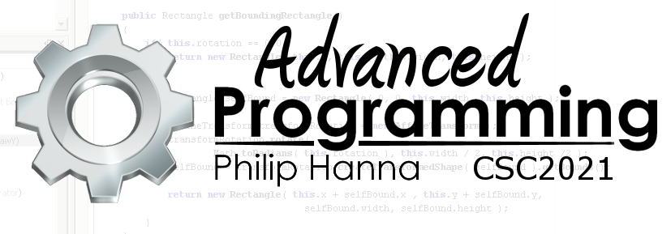
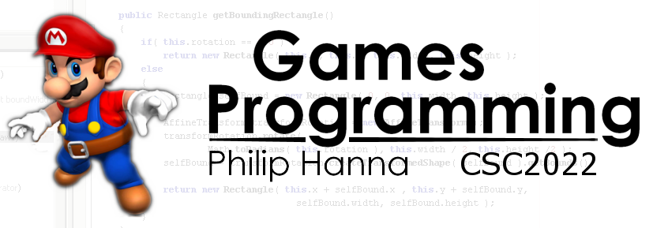
Graphics
Images within 2D games
Part 3 – Displaying Text

Slide 2
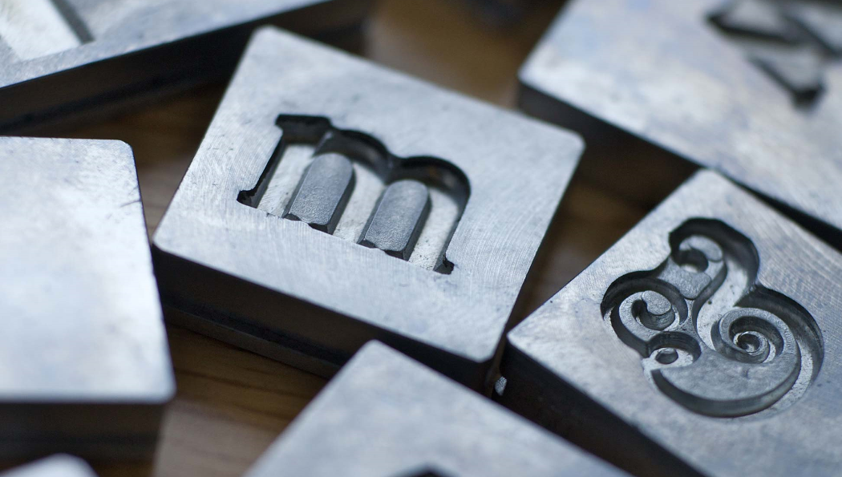
Drawing Text

Slide 3

: The Expense of Drawing A Font
Most modern fonts (e.g. TrueType) are outline based – a set of line and curve equations describing the shape of each ‘glyph’ (character).
When drawing a font, the outline is rendered and then filled by an ink colour.
Using this approach to render text once per frame (i.e. 50-60 times per second) is needlessly inefficient.

Slide 4
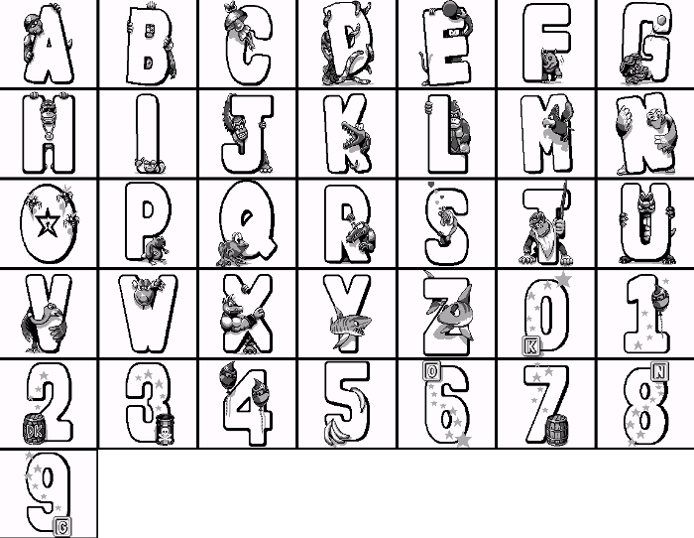
: Bitmap Fonts
Early fonts were bitmap based. Effectively a bitmap representation was drawn to represent the character.
The same technique can be used within games. The character glyphs are rendered once to an appropriately sized bitmap which is then used for subsequent draw requests.

Slide 5
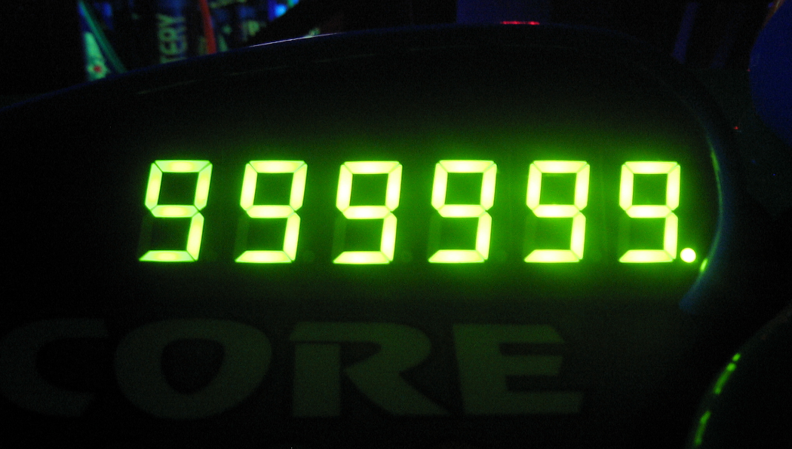
Numeric Text

Slide 6

Exercise: Using digit arrays
Assume you have a series of images representing the digits 0 to 9 stored in an array
Develop an approach that will take a positive integer score and graphically illustrate it using the image sequence.
1 | Bitmap[] digits = new Bitmap[10];
2
Start
10 mins
9 mins
8 mins
7 mins
6 mins
5 mins
4 mins
3 mins
2 mins
1 min
30 sec
Finished

Slide 7
The modulus (%) operator can be used to extract the last digit in the score.
Using integer division, the last digit can then be removed and the process iterated until no more digits remain. This draws the score right-to-left.
1 | void drawScore(int targetScore) {
2 | int scoreFragment = targetScore;
3 | do {
4 | int digit = scoreFragment % 10;
5 | draw(digitImage[digit]);
6
7 | scoreFragment = scoreFragment / 10;
8 | } while (scoreFragment > 9);
9 | }

Slide 8

Key takeaways:
Text (alphabetic and numeric) is displayed in a game in much the same way as are images.

